Slide 1

Titration Nation An Automatic Titrating Machine
Nick DeGroot and Trevor “Serious” Li

Slide 2
Special Shoutouts
Eric Snell,
Allen Zhang,
Michael Zhao,
Andrew Liu
-- The Ti-Traitors --

Slide 3
Special Shoutouts
Jon Meinhardt
Mr. Grosse
Max the Chu Chu train
Mr. Vernier

Slide 4
Why it’s applicable

Slide 5
Come on, really?

Slide 6
Recap: What is a Titration?

Slide 7
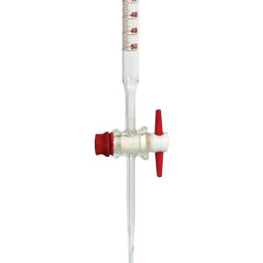
The best way to drop the base
...or the acid
Requires your full...concentration
Calculating the amount of [H+] or [OH-] in a solution via the neutralization reaction
That’s Basic-ly it.
Stop overreacting to these jokes
Also the thing that Allen’s lab group can’t do in a full period

Slide 8
Planning

Slide 9

Talking with Experts
We needed some ideas on how to get everything to work together
Original idea was to use a pump to get base into acid
Not feasible given time and material constraints
We Ve-nearly scrapped the idea.
Called Vernier, got put through to Dave Vernier
Helped us with pump idea, thought we should use a DCU

Slide 10
Finalizing the Idea
Finally settled on using a photogate
Measured out how much volume was in one drop of base
One drop around 0.045 mL
Talking with others about calculus involved
(Jon may have moved on, but he is in Mein-hardt ♥️)
Creating the wiring diagram

Slide 11
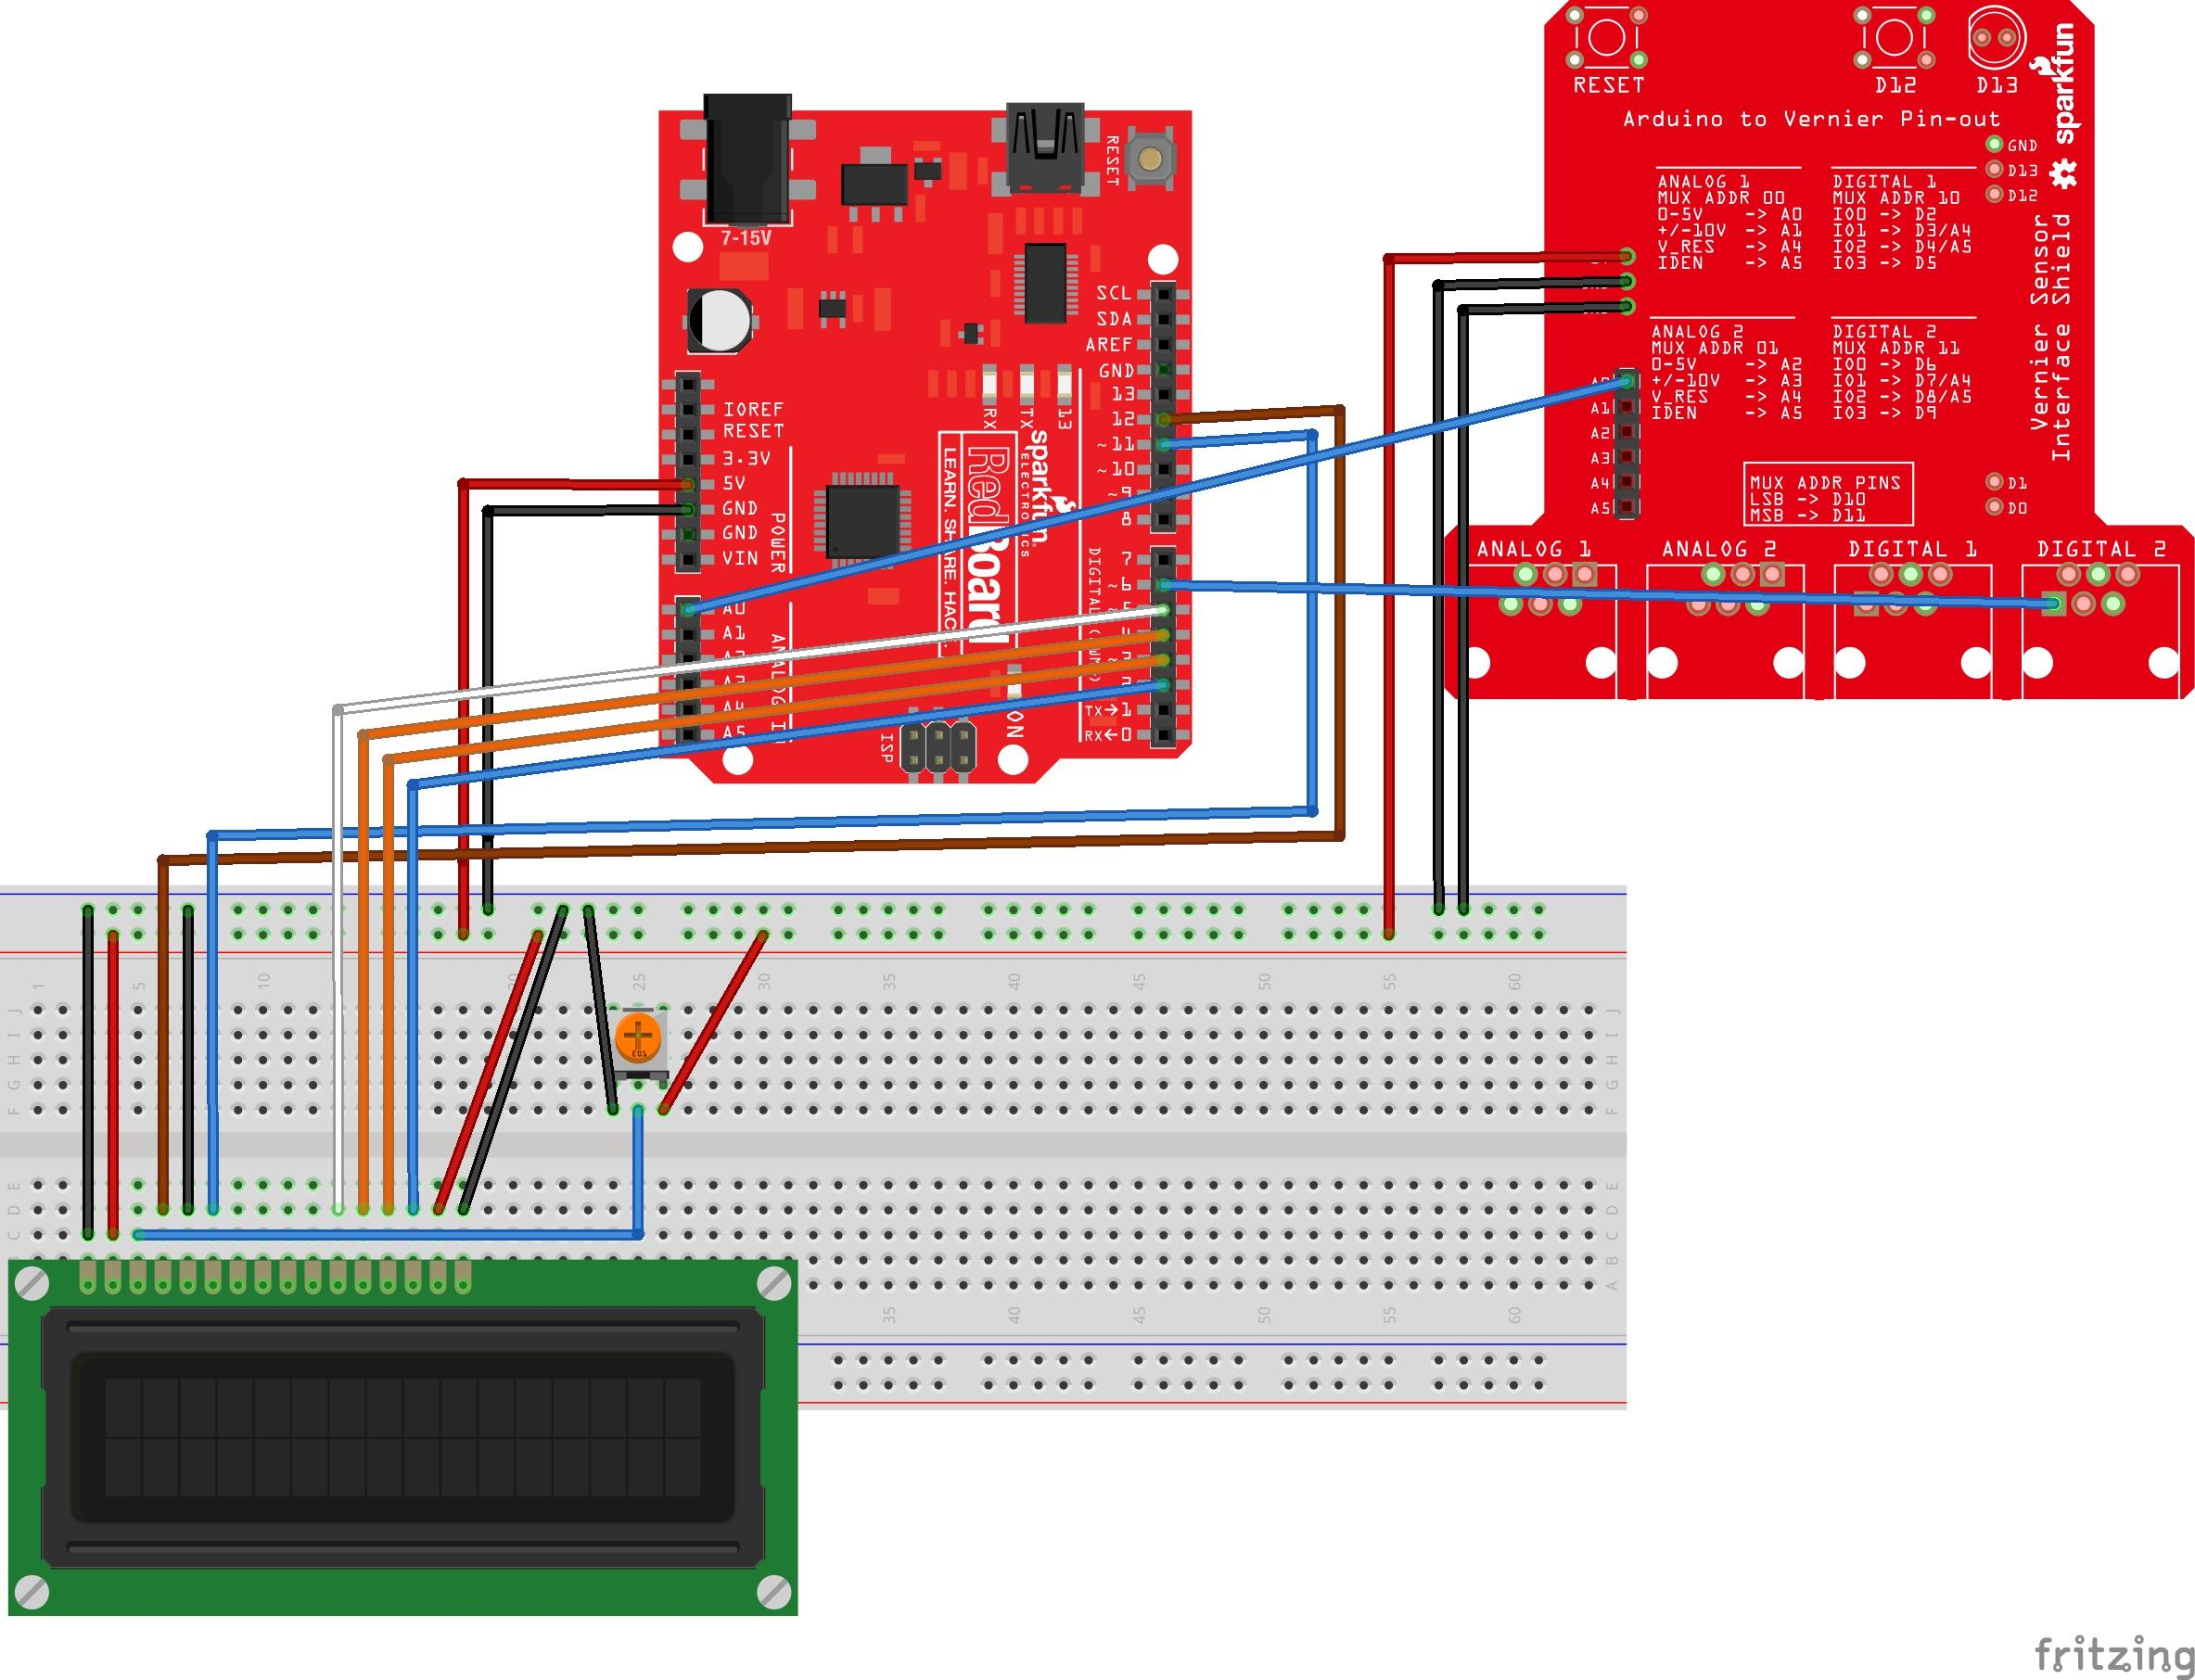

Slide 12
PArts LIst
Arduino (1)
USB adapter cable (1)
Burette (1)
Vernier pH sensor (1)
Computer (1)
Vernier Arduino interface shield (1)
Vernier Photogate (1)
Retort stand (1)
Clamps (2)
Magnetic stir stick (1)
Stir Plate (1)
100ml Beaker (1)
Glass funnel (1)
50ml beaker (1)
Ti-traitors (4)

Slide 13


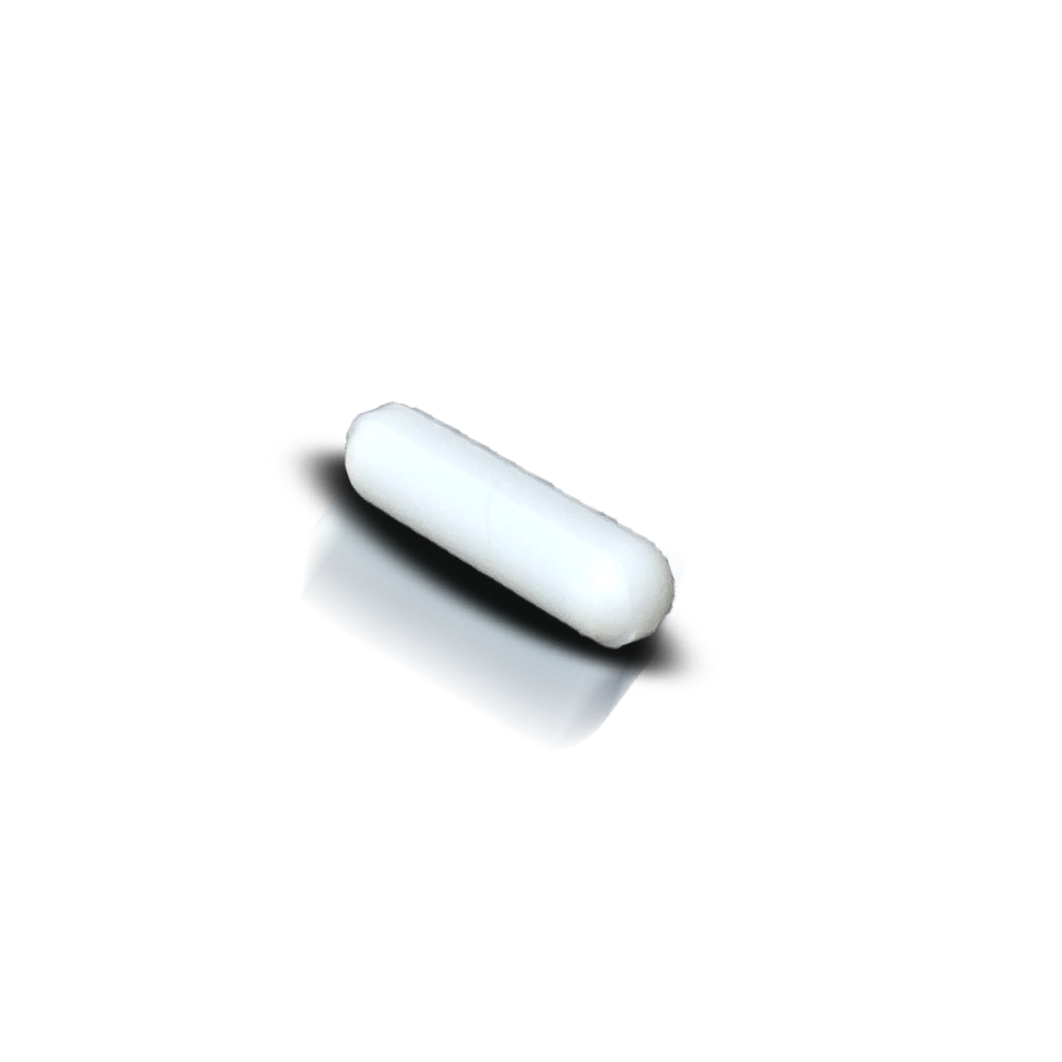
Assembly
Set up a general titration setup.
Set up arduino according to wiring guide, connecting pH to digital one and photogate to analog one.
Confirm photogate is set underneath burette, and drops are registered and counted.
Add stir rod into the beaker

Slide 14
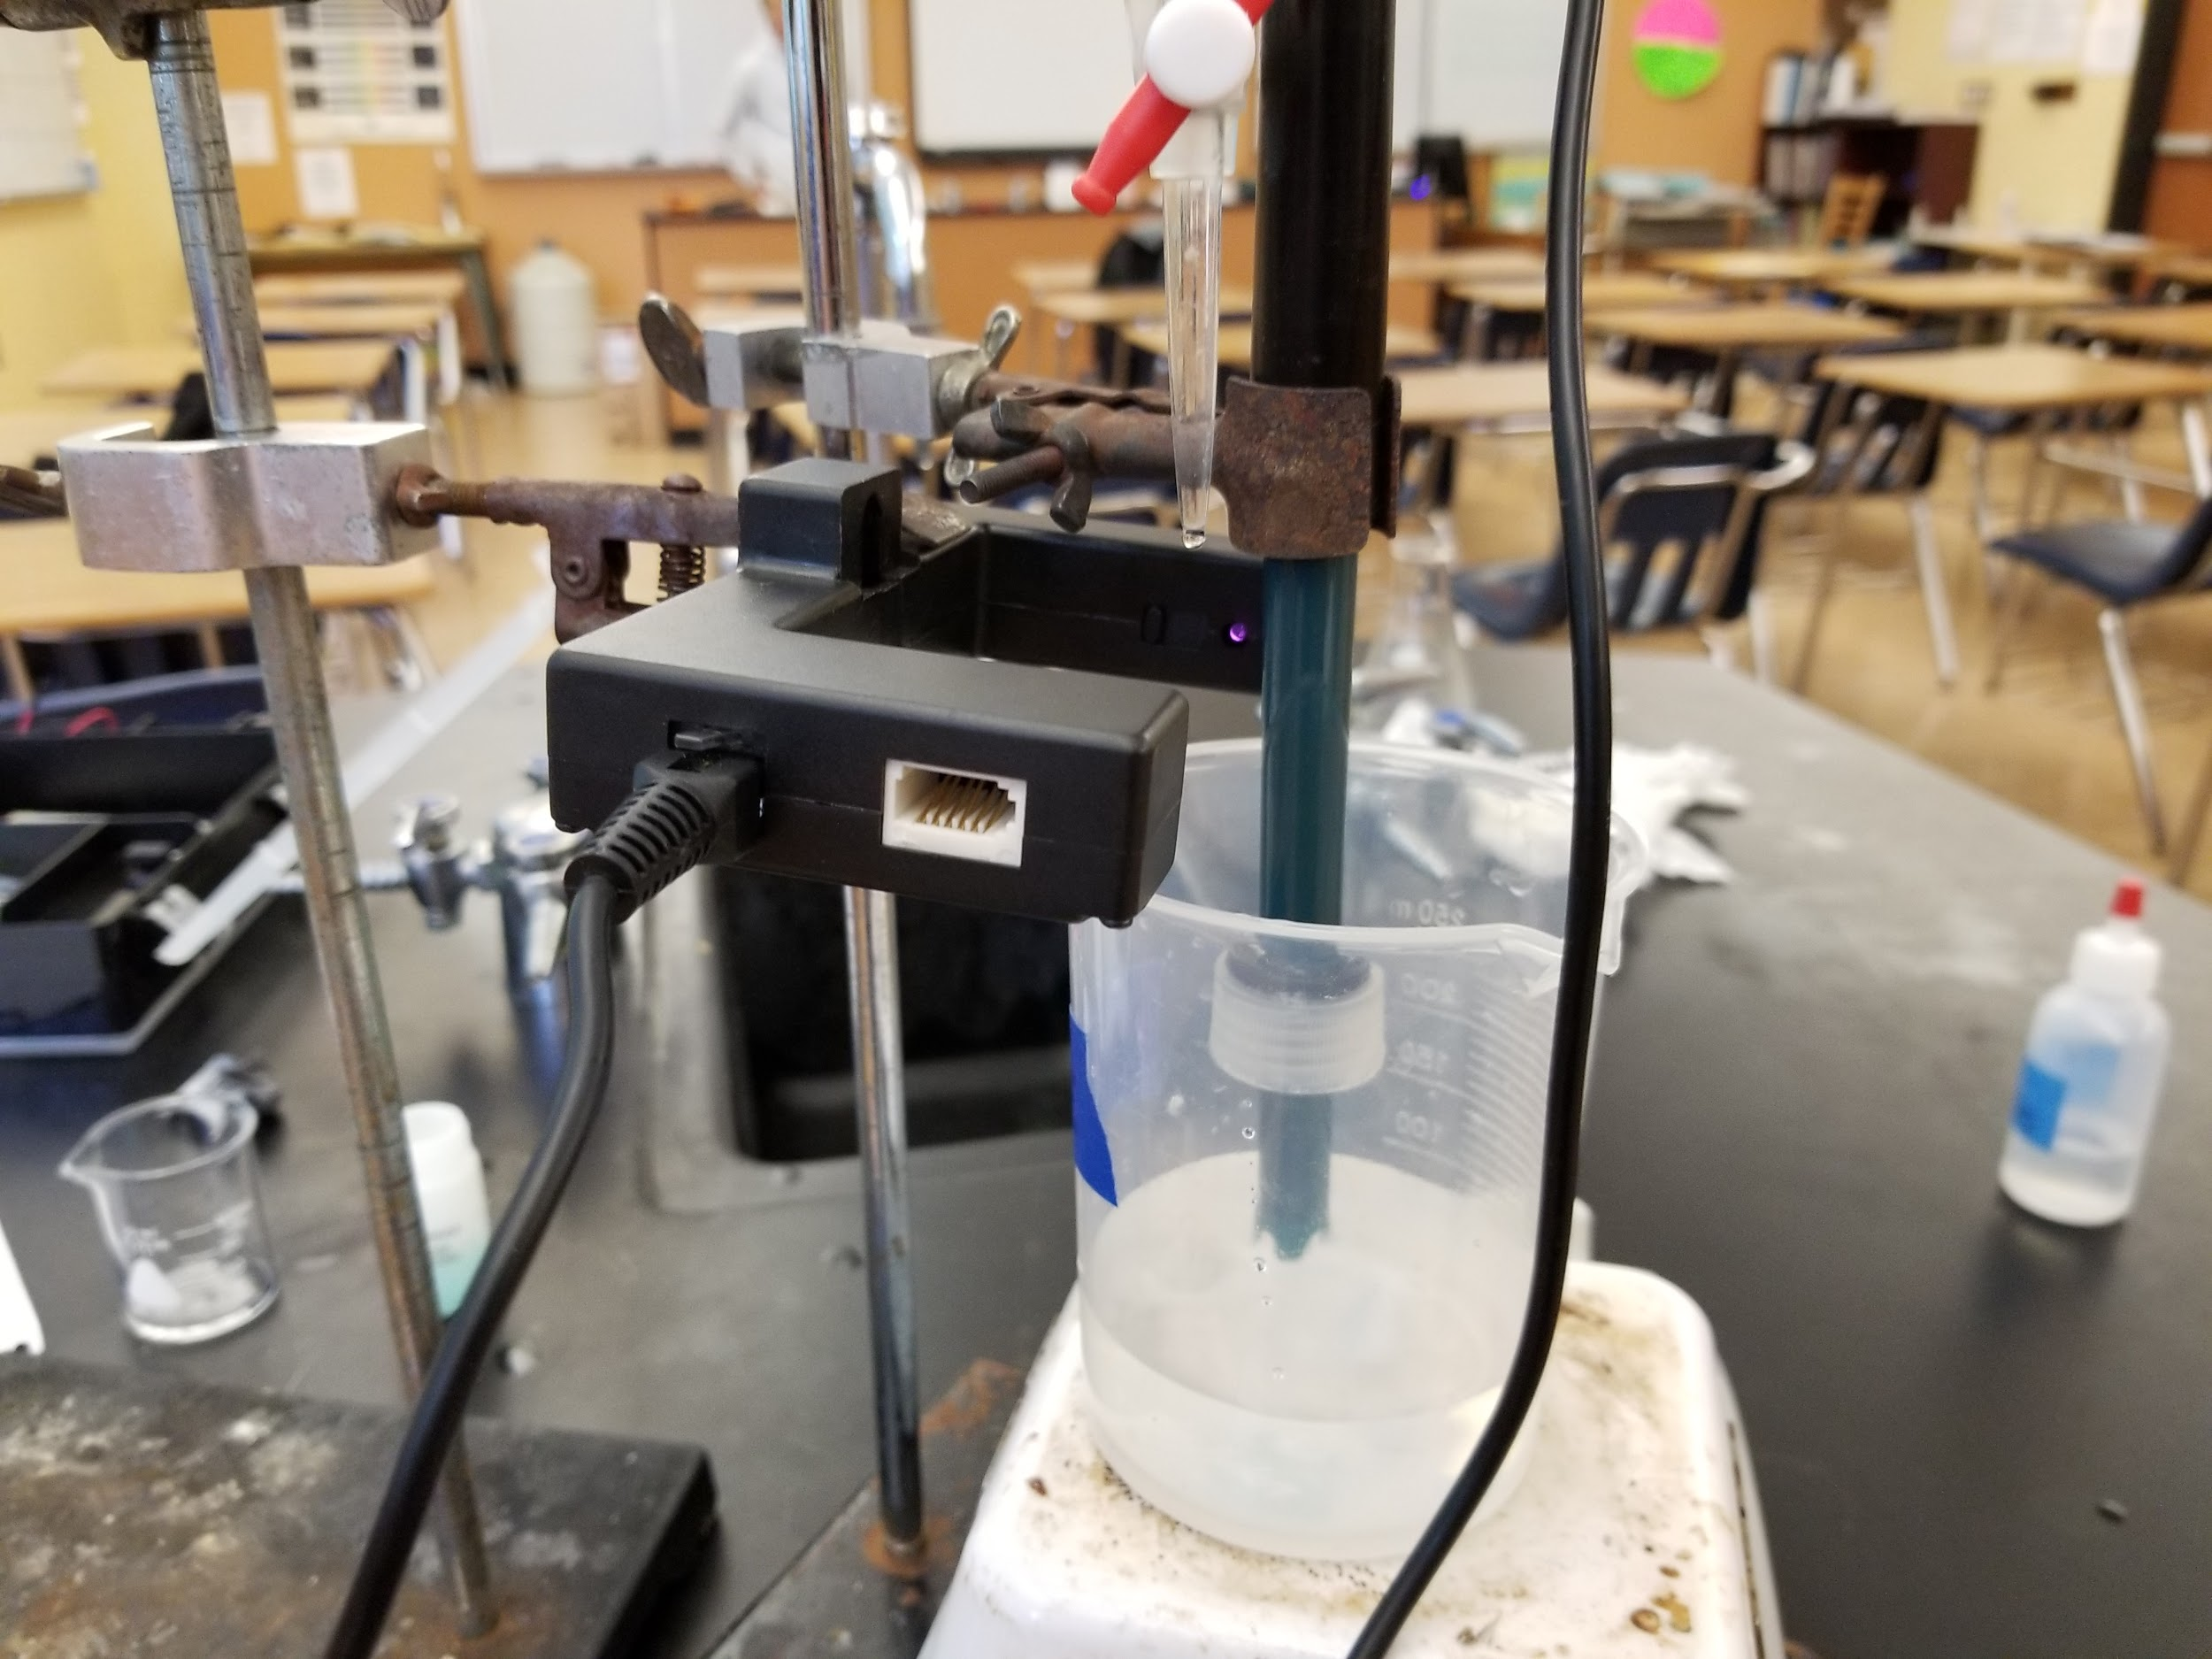

Slide 15
Developing

Slide 16
Problem One: How to get sensor data?
Computers read in binary: 0s and 1s.
For the photogate, this is easy
…but the pH meter?
Solution: send a changing voltage
Going through linear calibration
sensorValue = slope * voltage + intercept
Slope: -3.838
Intercept: 13.720
Simplified to Vernier.readSensor();
Ohm-a god
That’s Watt you gotta do

Slide 17
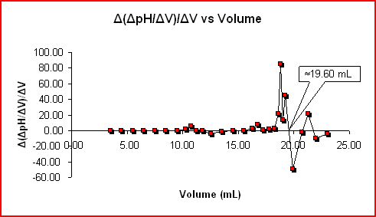
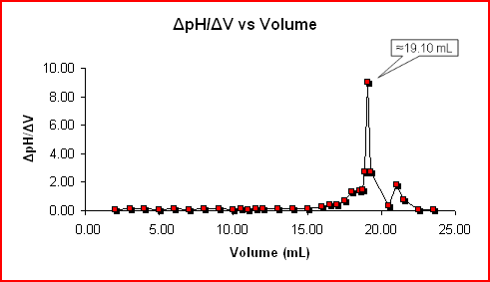
Problem Two: How to find the equivalence point
In maths, point we’re trying to find is the inflection point
Problem: there can be several inflection points using second derivative
Solution: use first derivative
The solution is also 0.1M NaOH

Slide 18
Problem 3: The LCD
¯\_(ツ)_/¯
The shield goes on top
All pins are taken
Ended up changing the design
Easier storage, and simpler setup

Slide 19
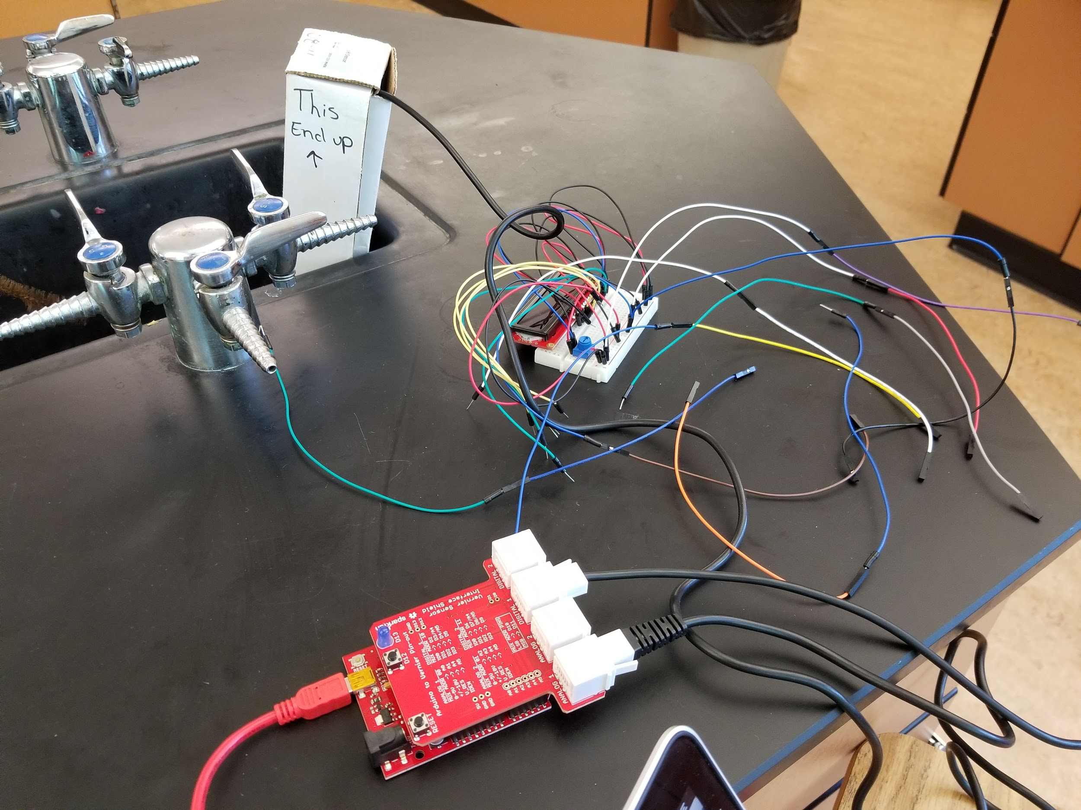
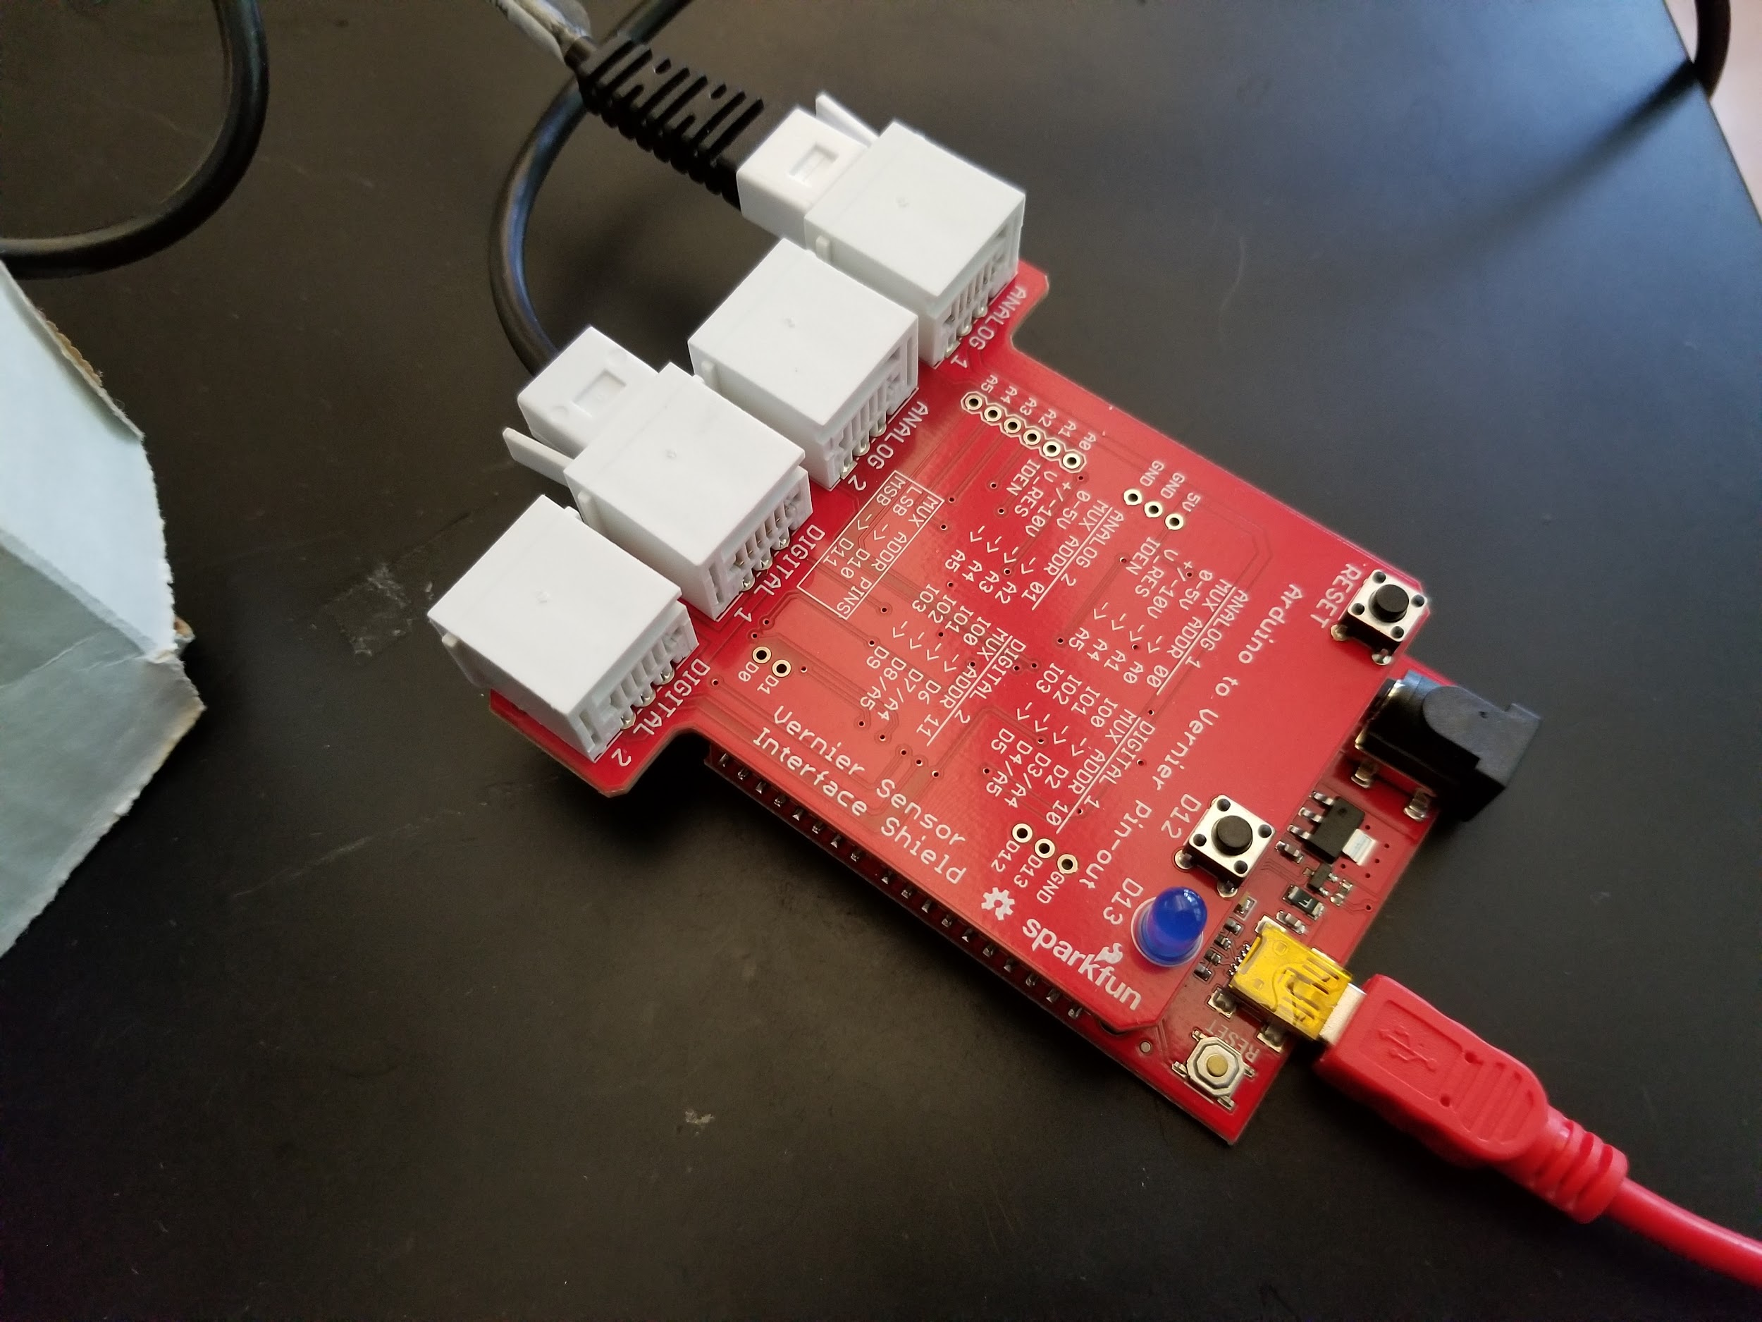

Slide 20
The Code
It brings everything together.
“Does anyone like to code? No!” - Mr. Grosse

Slide 21
float sensorPh = Vernier.readSensor(); // Getting pH
int photogate = digitalRead(2); // Low when blocked
if (photogate == LOW) {
if (!gateFlipped) {
gateFlipped = true;
mlBase += 0.05;
float firstDeriv = (sensorPh - pH) / (0.05);
if (highestDeriv < firstDeriv) {
highestDeriv = firstDeriv;
mlBaseForNeutralization = mlBase;
// Calculating predicted molarity for current values
float molBase = (mlBase / 1000) * molarBase;
float molAcid = molBase;
molarAcid = molAcid / (mlAcid / 1000);
}
...
Unlike the titanic

Slide 22
Testing

Slide 23
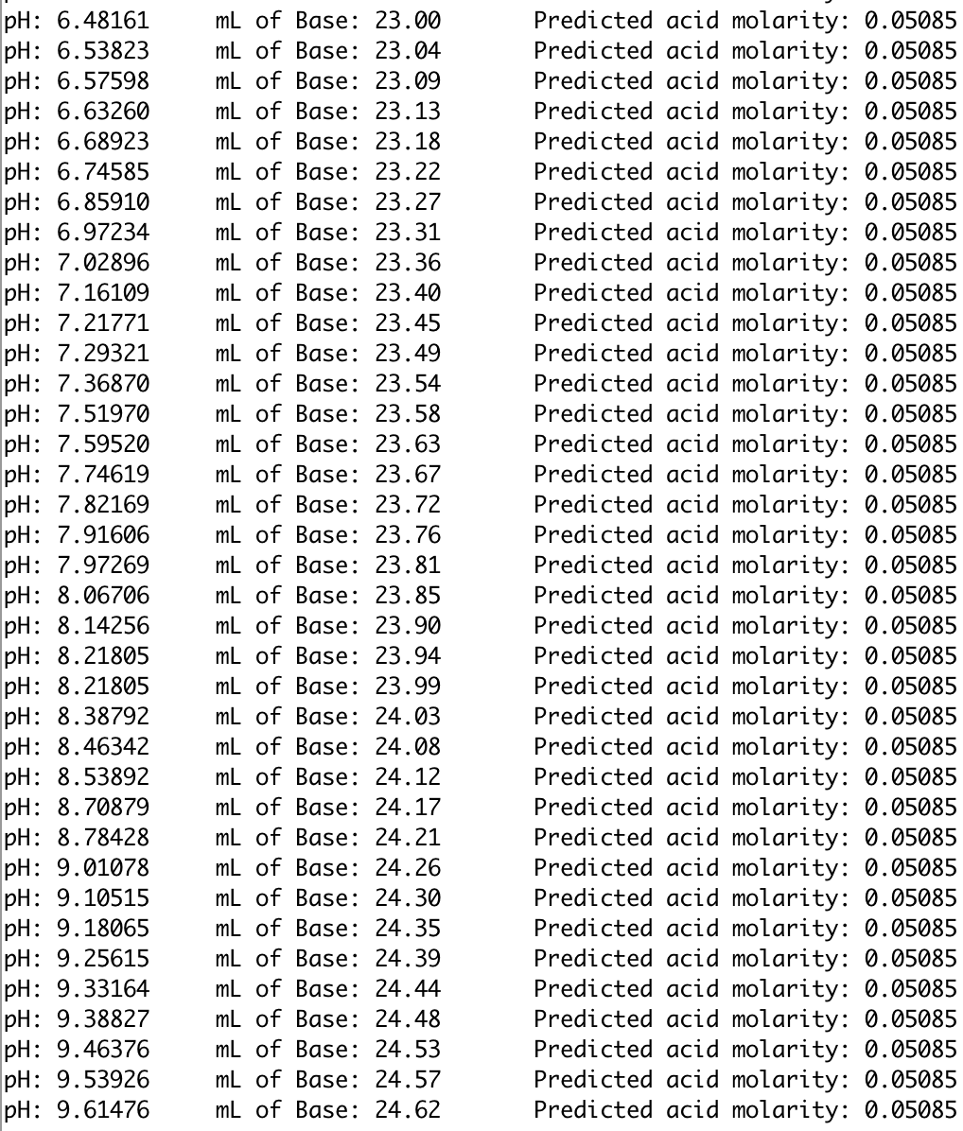
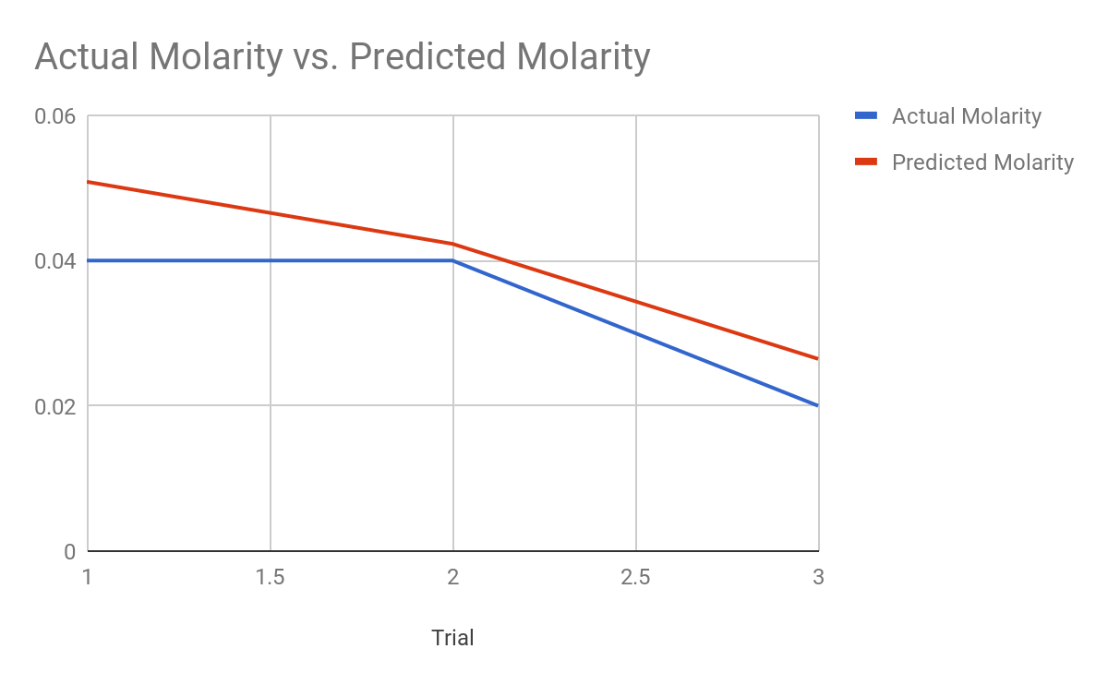
Trials and tribbleations

Slide 24
Analyzing
Average Percent Error: 21.73%
Inaccurate measurements
Taking too long to react (Just like y’all to Trevor’s puns)
Drop offset
Temp not held constant (Ka of water changes with temp)
Carbonic Acid/ other dissolved gases
Other solutes

Slide 25
Post-Project

Slide 26


Post Project Fun

Slide 27
Summary

Slide 28
TL;DR
The members of Titration nation made a semi auto titration machine.
Plug in ml of solution into the code, let it drip, and
Wata (H+OH)

Slide 29
Sources
https://www.vernier.com/engineering/arduino/

Slide 30
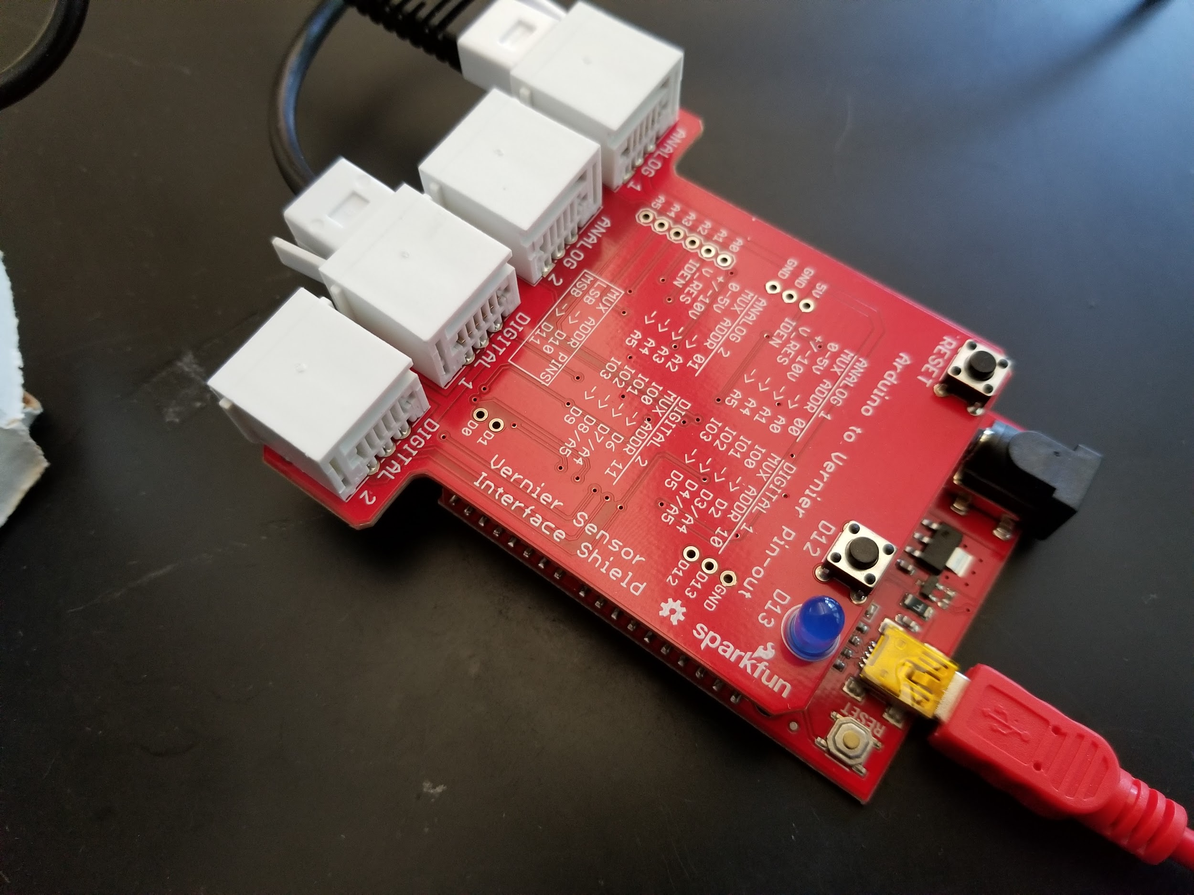
This is the END POINT of our project

